Slide 1
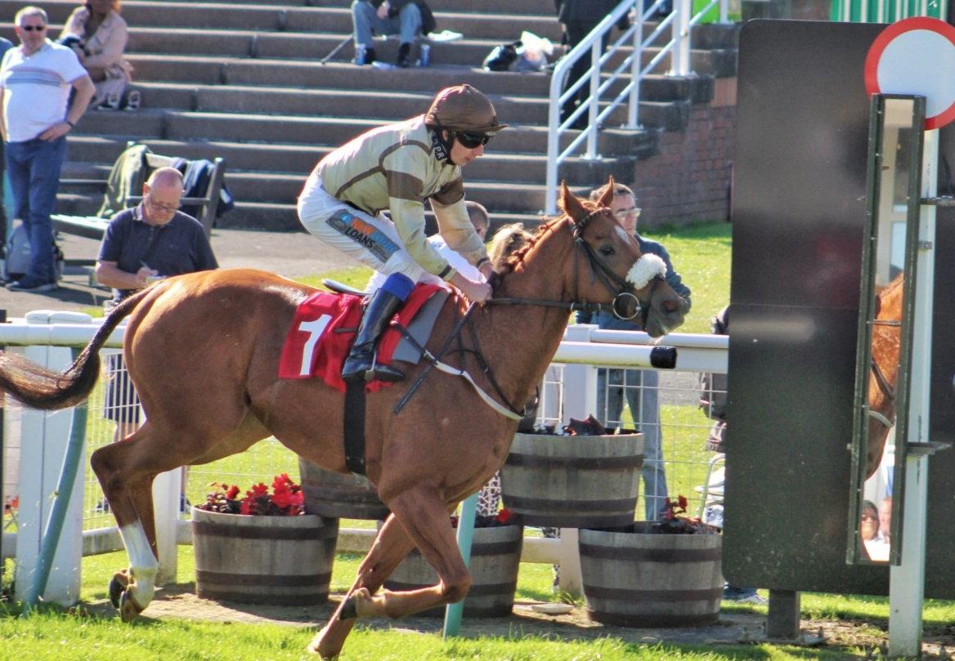
Streak Lightning
Trained by Ruth Carr
NEW LEASE SHARE OFFER - ONE OFf PAYMENT OF ONLY £175 FOR THE WHOLE OF 2023!!
OR
LIMITED lease SHARES AVAILABLE of 2.5% AT £75 PER MONTH, which guarantees you an owner's badge when he runs.
We bought him out of Mark Johnston's yard. He has shown from his two wins on turf & tHREE wins on the allweather, that he is very versatile to all kinds of surfaces. Unlike most racing clubs, membership is restricted to only 100 members
Benefits of the offer are as follows:
One Off Payment of Only £175 all-inclusive for the rest of 2023 or 2.5% at £75 per month. The 2.5% guarantees an owner’s badge
Welcome Pack
Race Day Badges(on a draw rota basis)
Text & Email messages of all entries & declarations
Race Reports
Stable Visits
Your Percentage of all Prize Money
Dedicated Owners Website Login Page
As well as Invites to all GPR Social Events.
An Ideal Gift for any Racing Enthusiast!!!

